Slide 1


Associazione tra Posizione Socio-Economica, Indicatori Antropometrici ed Esiti di Salute in una Coorte Femminile Italiana (Studio EPIC-Italia)
Teresa Speranza
Unità di Statistica Medica, Università degli Studi della Campania “Luigi Vanvitelli”, Napoli.

Slide 2
Framework & Aims
Socioeconomic Position
Health Outcomes

Slide 3

Framework & Aims
Socioeconomic Position
Health Outcomes

Slide 4
Framework & Aims
Socioeconomic Position
Health Outcomes
Risk Factors
Clinical –Lifestyle - Anthropometric

Slide 5






Framework & Aims
EPIC-Italy study
The European Prospective Investigation into Cancer and Nutrition (EPIC-Europe) is a long-term, large-scale collaborative project that studies different populations from countries across Europe to investigate the relationships between diet, nutrition, lifestyle, and environmental factors, and the incidence of cancer and other chronic diseases.
  521,000+ healthy participants
  10 European Countries
  30+ years of longitudinal follow-up
  Focus on nutrition, lifestyle, and disease linkage
Multicenter prospective cohort study
5 centers (Varese, Torino, Firenze, Napoli and Ragusa)
47.000 healthy participants (males and females) ;
Aged between 35 and 70;
Recruited between 1992 and 1998.

Slide 6
Framework & Aims
EPIC-Italy study
The European Prospective Investigation into Cancer and Nutrition (EPIC-Europe) is a long-term, large-scale collaborative project that studies different populations from countries across Europe to investigate the relationships between diet, nutrition, lifestyle, and environmental factors, and the incidence of cancer and other chronic diseases.
  521,000+ healthy participants
  10 European Countries
  30+ years of longitudinal follow-up
  Focus on nutrition, lifestyle, and disease linkage
Multicenter prospective cohort study
5 centers (Varese, Torino, Firenze, Napoli and Ragusa)
47.000 healthy participants (males and females) ;
Aged between 35 and 70;
Recruited between 1992 and 1998.
Only 29.494 women were included
(those with complete data regarding the study's core variables).

Slide 7
Framework & Aims
EPIC-Italy study
The European Prospective Investigation into Cancer and Nutrition (EPIC-Europe) is a long-term, large-scale collaborative project that studies different populations from countries across Europe to investigate the relationships between diet, nutrition, lifestyle, and environmental factors, and the incidence of cancer and other chronic diseases.
  521,000+ healthy participants
  10 European Countries
  30+ years of longitudinal follow-up
  Focus on nutrition, lifestyle, and disease linkage
Multicenter prospective cohort study
5 centers (Varese, Torino, Firenze, Napoli and Ragusa)
47.000 healthy participants (males and females) ;
Aged between 35 and 70;
Recruited between 1992 and 1998.
Only 29.494 women were included
(those with complete data regarding the study's core variables).

Slide 8
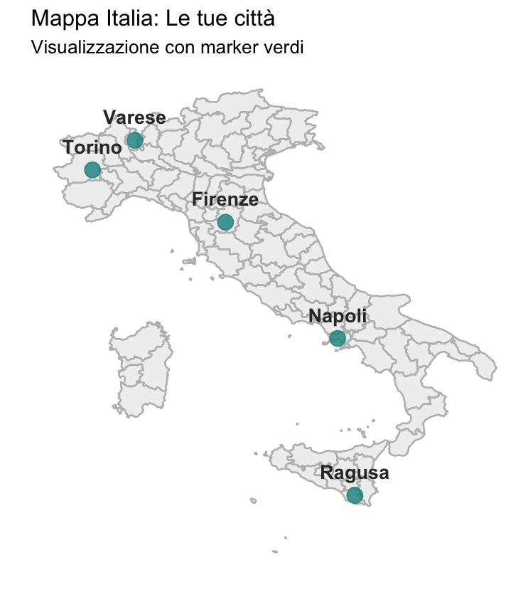
Socioeconomic Indicators
Firenze
Population | N=9,713; 33%
updated to December 31. 2018
Varese
Population | N=9,050; 31%
updated to December 31. 2012
Napoli
Population | N=4,585; 16%
updated to December 31. 2016
from Progetto ATENA
Torino
Population | N=3,097; 11%
updated to December 31. 2020
Ragusa
Population | N=3,049; 10%
updated to December 31. 2014
Median follow-up: 22.1 anni

Slide 9



Socioeconomic Indicators
Deprivation Index (DI)
2001 Census
Relative Index of Inequality (RII)
Territorial indicator of socioeconomic status;
Calculated at the census block level and linked to the residential address through georeferencing procedures;
Quintiles representing increasing levels of social deprivation (Q1, Q2, Q3, Q4, Q5).
Individual indicator of socioeconomic position;
Measure of educational attainment (avoiding the issue of varying distribution of qualifications across different birth cohorts);
Tertiles representing decreasing levels of education (RII 1, RII 2, RII 3).
Repeated measures correlation between indices: r = 0.16

Slide 10
Socioeconomic Indicators
Firenze
Q1 | 2,664 (27%)
Q2 | 2,209 (23%)
Q3 | 2,019 (21%)
Q4 | 1,856 (19%)
Q5 | 965 (10%)
RII 1 | 3,099 (32%)
RII 2 | 3,281 (34%)
RII 3 | 3,333 (34%)
Varese
Q1 | 1,670 (18%)
Q2 | 2,512 (28%)
Q3 | 2,431 (27%)
Q4 | 1,629 (18%)
Q5 | 808 (8.9%)
RII 1 | 2,900 (32%)
RII 2 | 3,043 (34%)
RII 3 | 3,107 (34%)
Napoli
Q1 | 128 (2.8%)
Q2 | 261 (5.7%)
Q3 | 493 (11%)
Q4 | 934 (20%)
Q5 | 2,769 (60%)
RII 1 | 1,946 (42%)
RII 2 | 1,351 (29%)
RII 3 | 1,288 (28%)
Torino
Q1 | 852 (28%)
Q2 | 495 (16%)
Q3 | 520 (17%)
Q4 | 562 (18%)
Q5 | 668 (22%)
RII 1 | 1,139 (37%)
RII 2 | 846 (27%)
RII 3 | 1,112 (36%)
Ragusa
Q1 | 568 (19%)
Q2 | 463 (15%)
Q3 | 452 (15%)
Q4 | 922 (30%)
Q5 | 644 (21%)
RII 1 | 729 (24%)
RII 2 | 1,347 (44%)
RII 3 | 973 (32%)

Slide 11
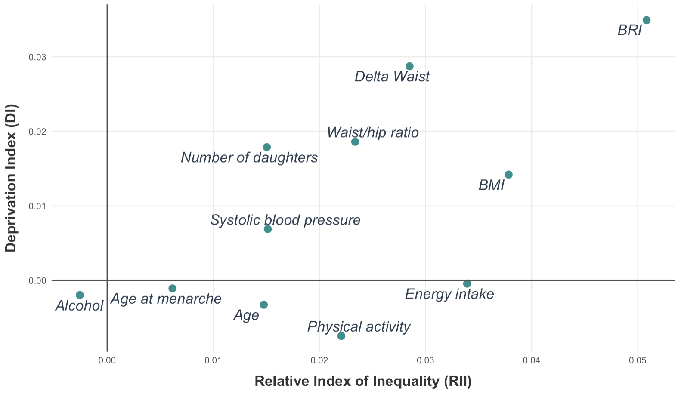
Baseline Characteristics
Smoking status
Differences between groups were assessed using linear regression models (for continuous variables) and logistic generalized linear models (for categorical variables); p-values were extracted via Type II ANOVA with heteroscedasticity-robust corrections and Chi-square tests, respectively.
The strength of the association was evaluated using eta-squared.
Diabetes
Menopause

Slide 12
Baseline Characteristics
Smoking status
Diabetes
Menopause

Slide 13


Survival Analysis
Progressively adjusted Cox regression models were used, stratified by age groups and center, to account for risk factors.
Each model included the Deprivation Index (DI) and the Relative Index of Inequality (RII).
The proportional hazards assumption was tested using Schoenfeld residuals.
adjusted for risk factors
Relative Index of Inequality
Deprivation Index
Center and age

Slide 14
Survival Analysis
Model 1
Model 3
Adjusted for clinical risk factors
Adjusted for anthropometric risk factors
adjusted for systolic blood pressure,
menopause, diabetes.
adjusted for adjusted for BMI and Delta Waist.
Model 2
Adjusted for lifestyle risk factors
Model 4
Full-adjusted
adjusted for physical activity, energy intake, alcohol, smoking status.
adjusted for variables included in Model 1, 2, and 3.

Slide 15
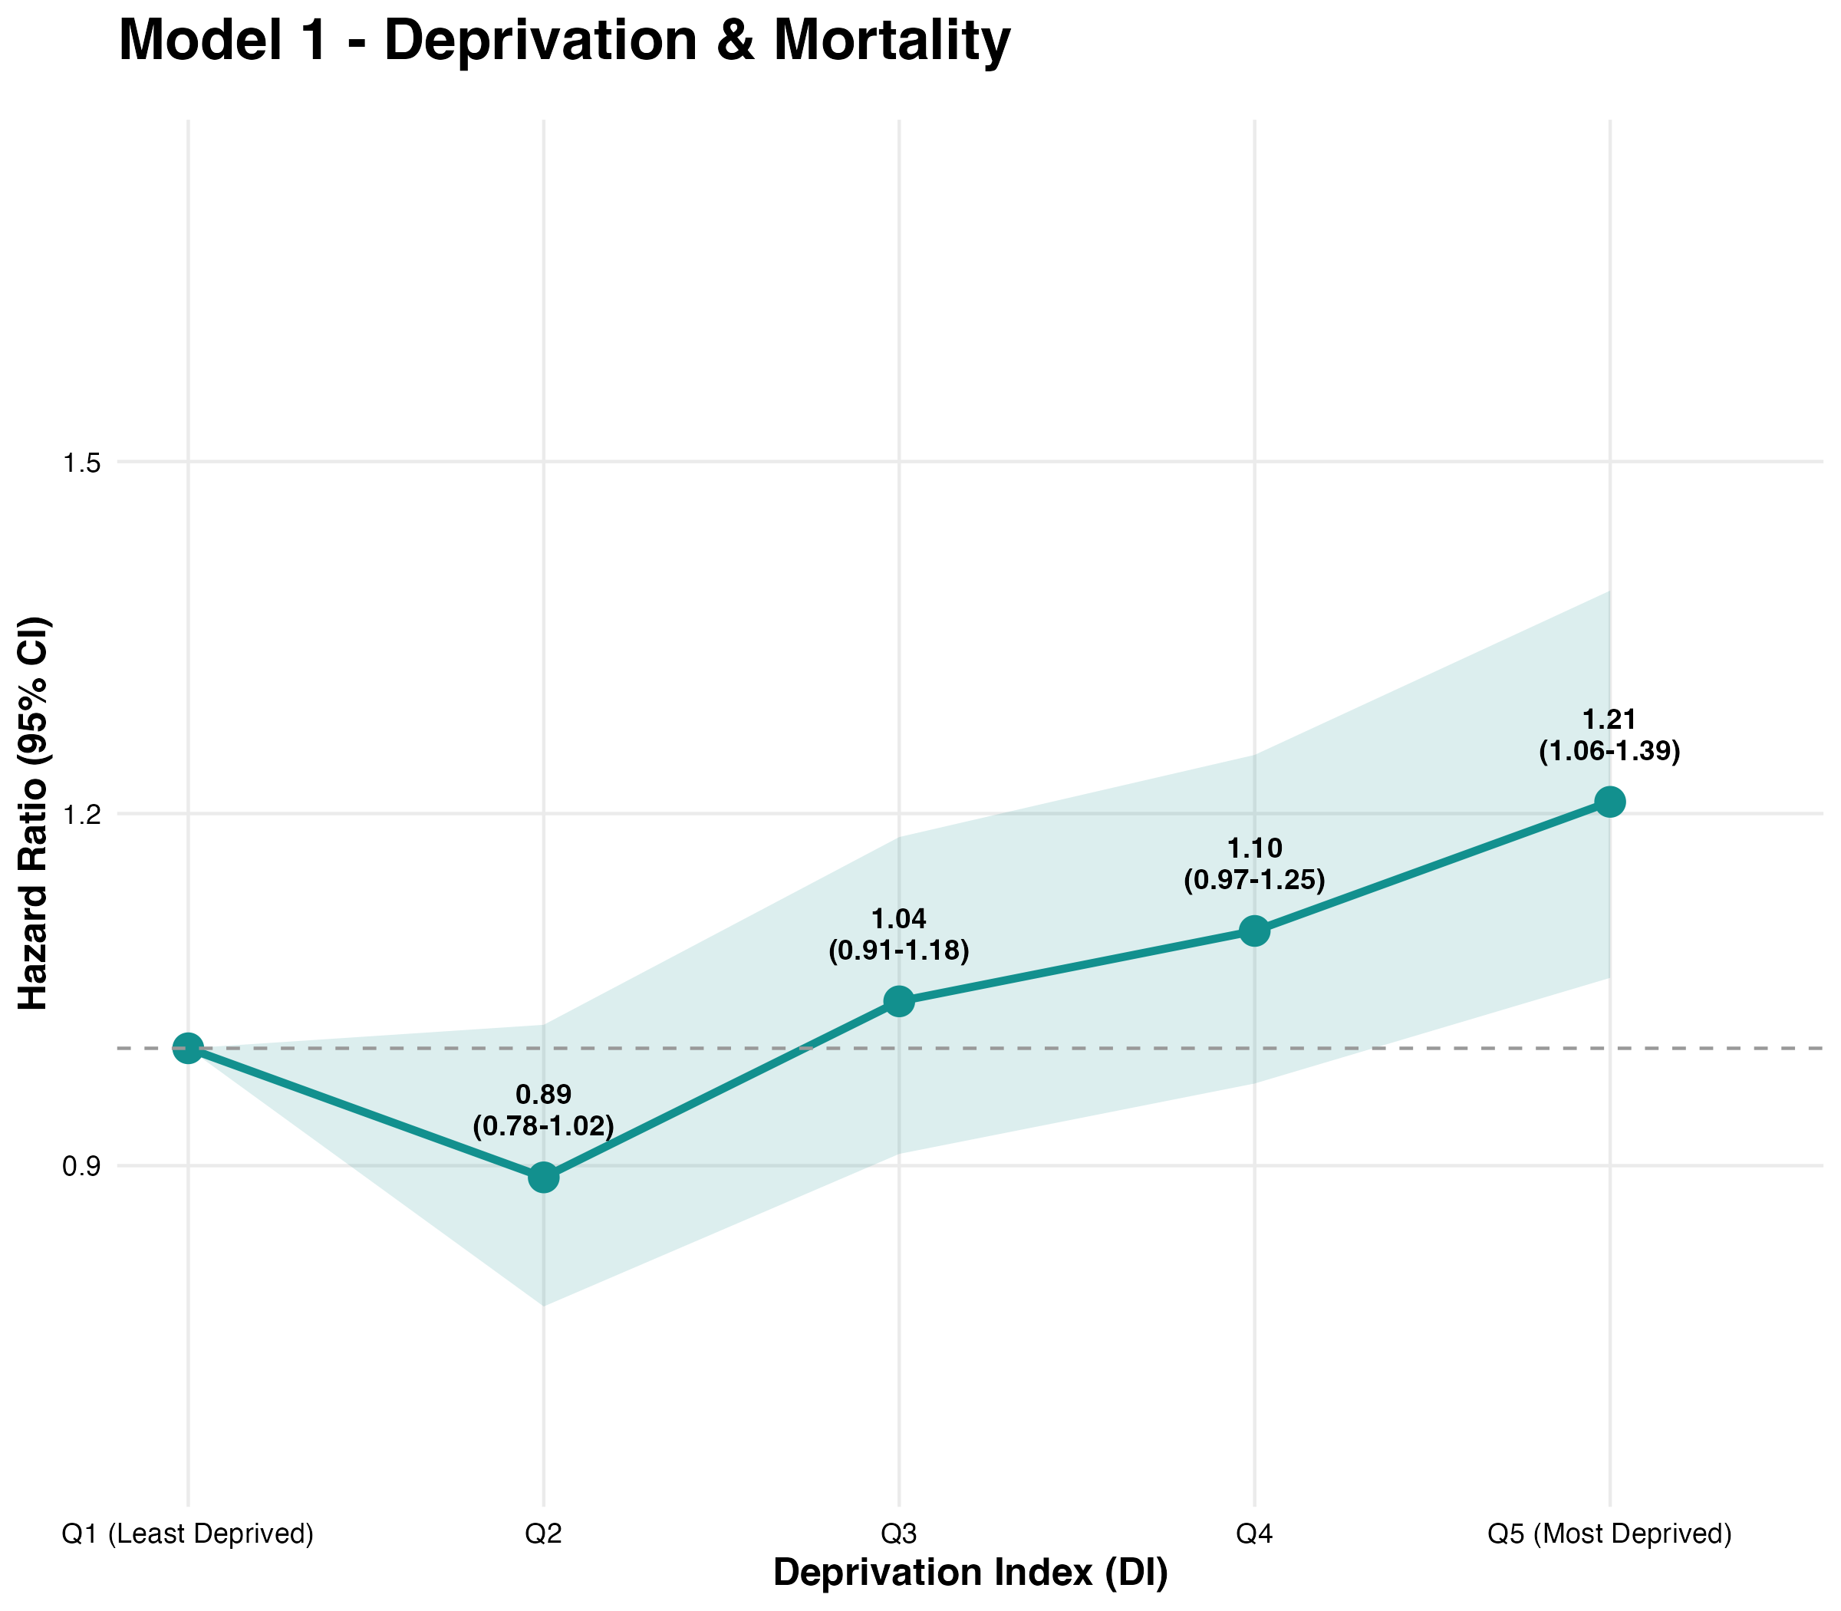



Survival Analysis
Mortality
 | Model 1 |  |  | Model 2 |  |  | Model 3 |  |  | Model 4
 | HR | 95% CI | p-value | HR | 95% CI | p-value | HR | 95% CI | p-value | HR | 95% CI | p-value
Deprivation Index
Q5 vs Q1 | 1.21 | 1.06-1.39 | 0.006 | 1.21 | 1.06- 1.39 | 0.006 | 1.20 | 1.05-1.38 | 0.009 | 1.19 | 1.04-1.37 | 0.013
p-value for trend |  |  | <0.001 |  |  | <0.001 |  |  | <0.001 |  |  | 0.001
Model 1: adjusted for systolic blood pressure, menopause, diabetes; Model 2: adjusted for physical activity, energy intake, alcohol, smoking status; Model 3: adjusted for BMI and Delta Waist; Model 4: full-adjusted.

Slide 16
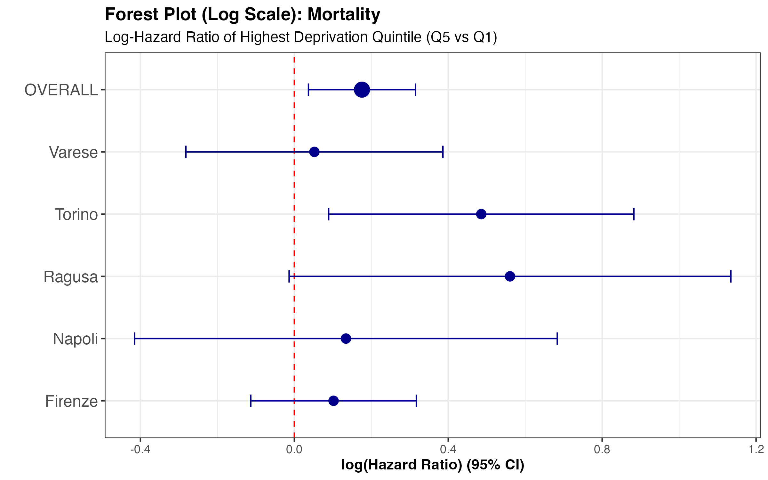
Survival Analysis
N=561
Population = 9,050
N=207
N=1,148
Population = 3,097
Population = 9,713
N=443
Population = 4,585
N=112
Population = 3,049

Slide 17
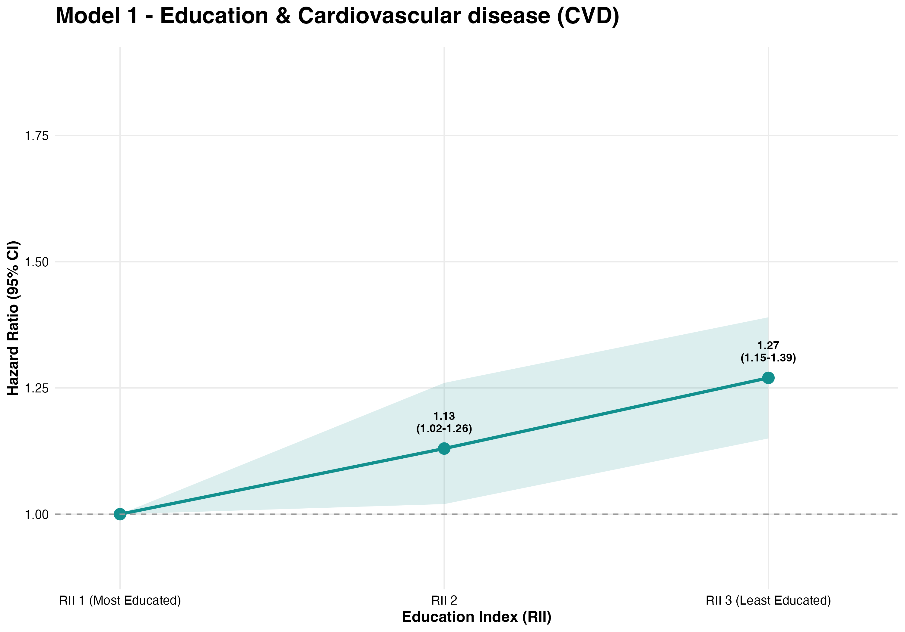
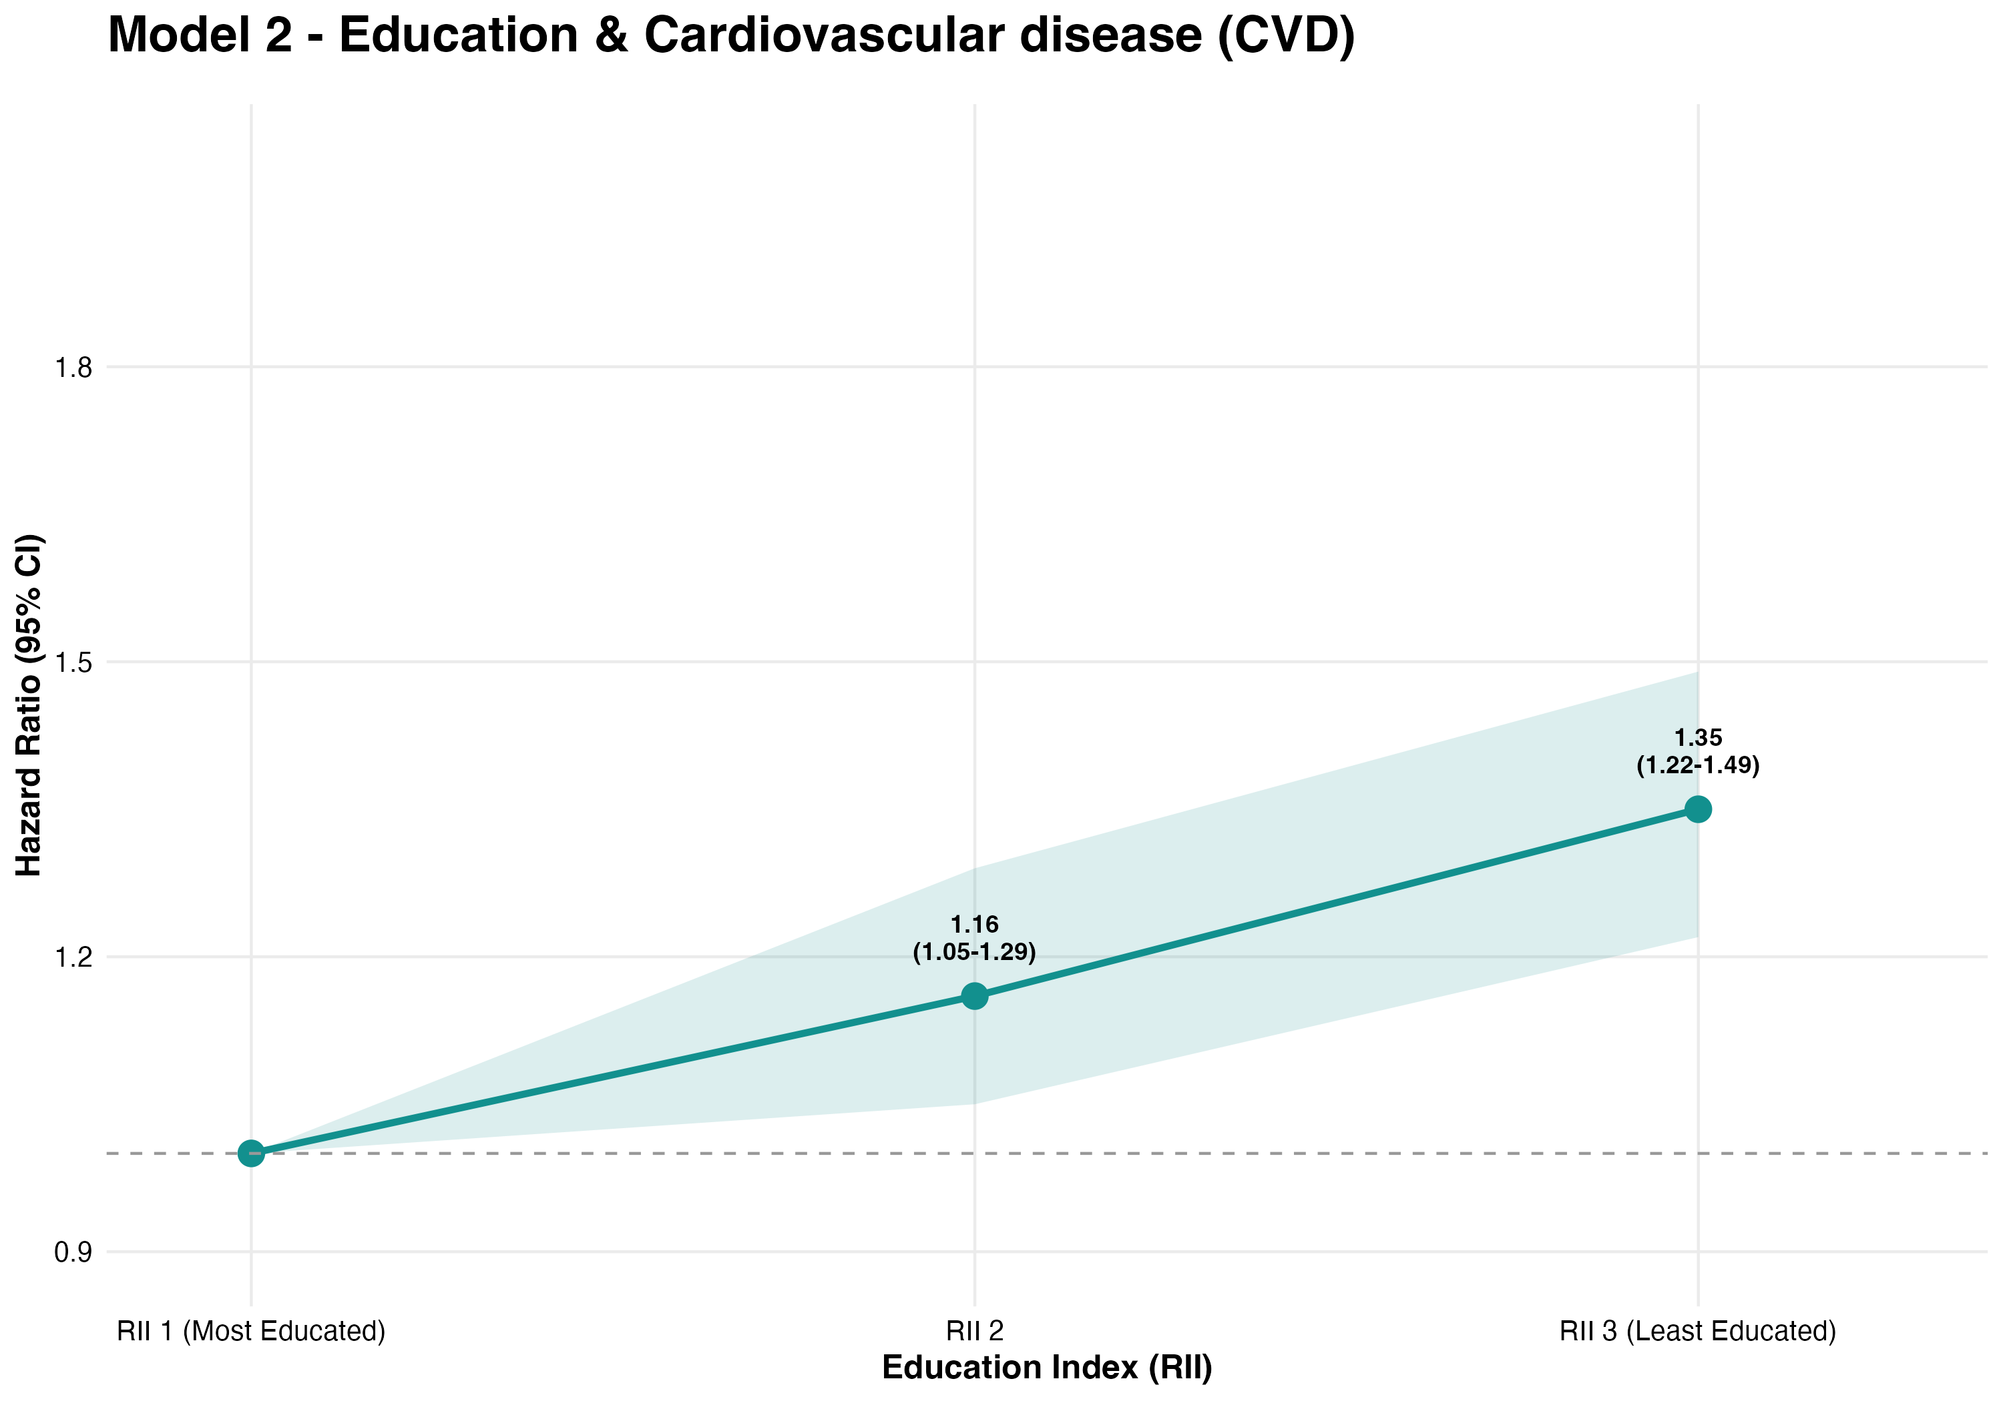


Survival Analysis
Cardiovascular Disease
 | Model 1 |  |  | Model 2 |  |  | Model 3 |  |  | Model 4
 | HR | 95% CI | p-value | HR | 95% CI | p-value | HR | 95% CI | p-value | HR | 95% CI | p-value
Education Index
RII 2 vs RII 1 | 1.13 | 1.02-1.26 | 0.016 | 1.16 | 1.05-1.29 | 0.003 | 1.14 | 1.03-1.26 | 0.011 | 1.13 | 1.02-1.25 | 0.021
RII 3 vs RII 1 | 1.27 | 1.15-1.39 | <0.001 | 1.35 | 1.22-1.49 | <0.001 | 1.28 | 1.16-1.41 | <0.001 | 1.23 | 1.12-1.36 | <0.001
p-value for trend |  |  | <0.001 |  |  | <0.001 |  |  | <0.001 |  |  | <0.001
Model 1: adjusted for systolic blood pressure, menopause, diabetes; Model 2: adjusted for physical activity, energy intake, alcohol, smoking status; Model 3: adjusted for BMI and Delta Waist; Model 4: full-adjusted.

Slide 18
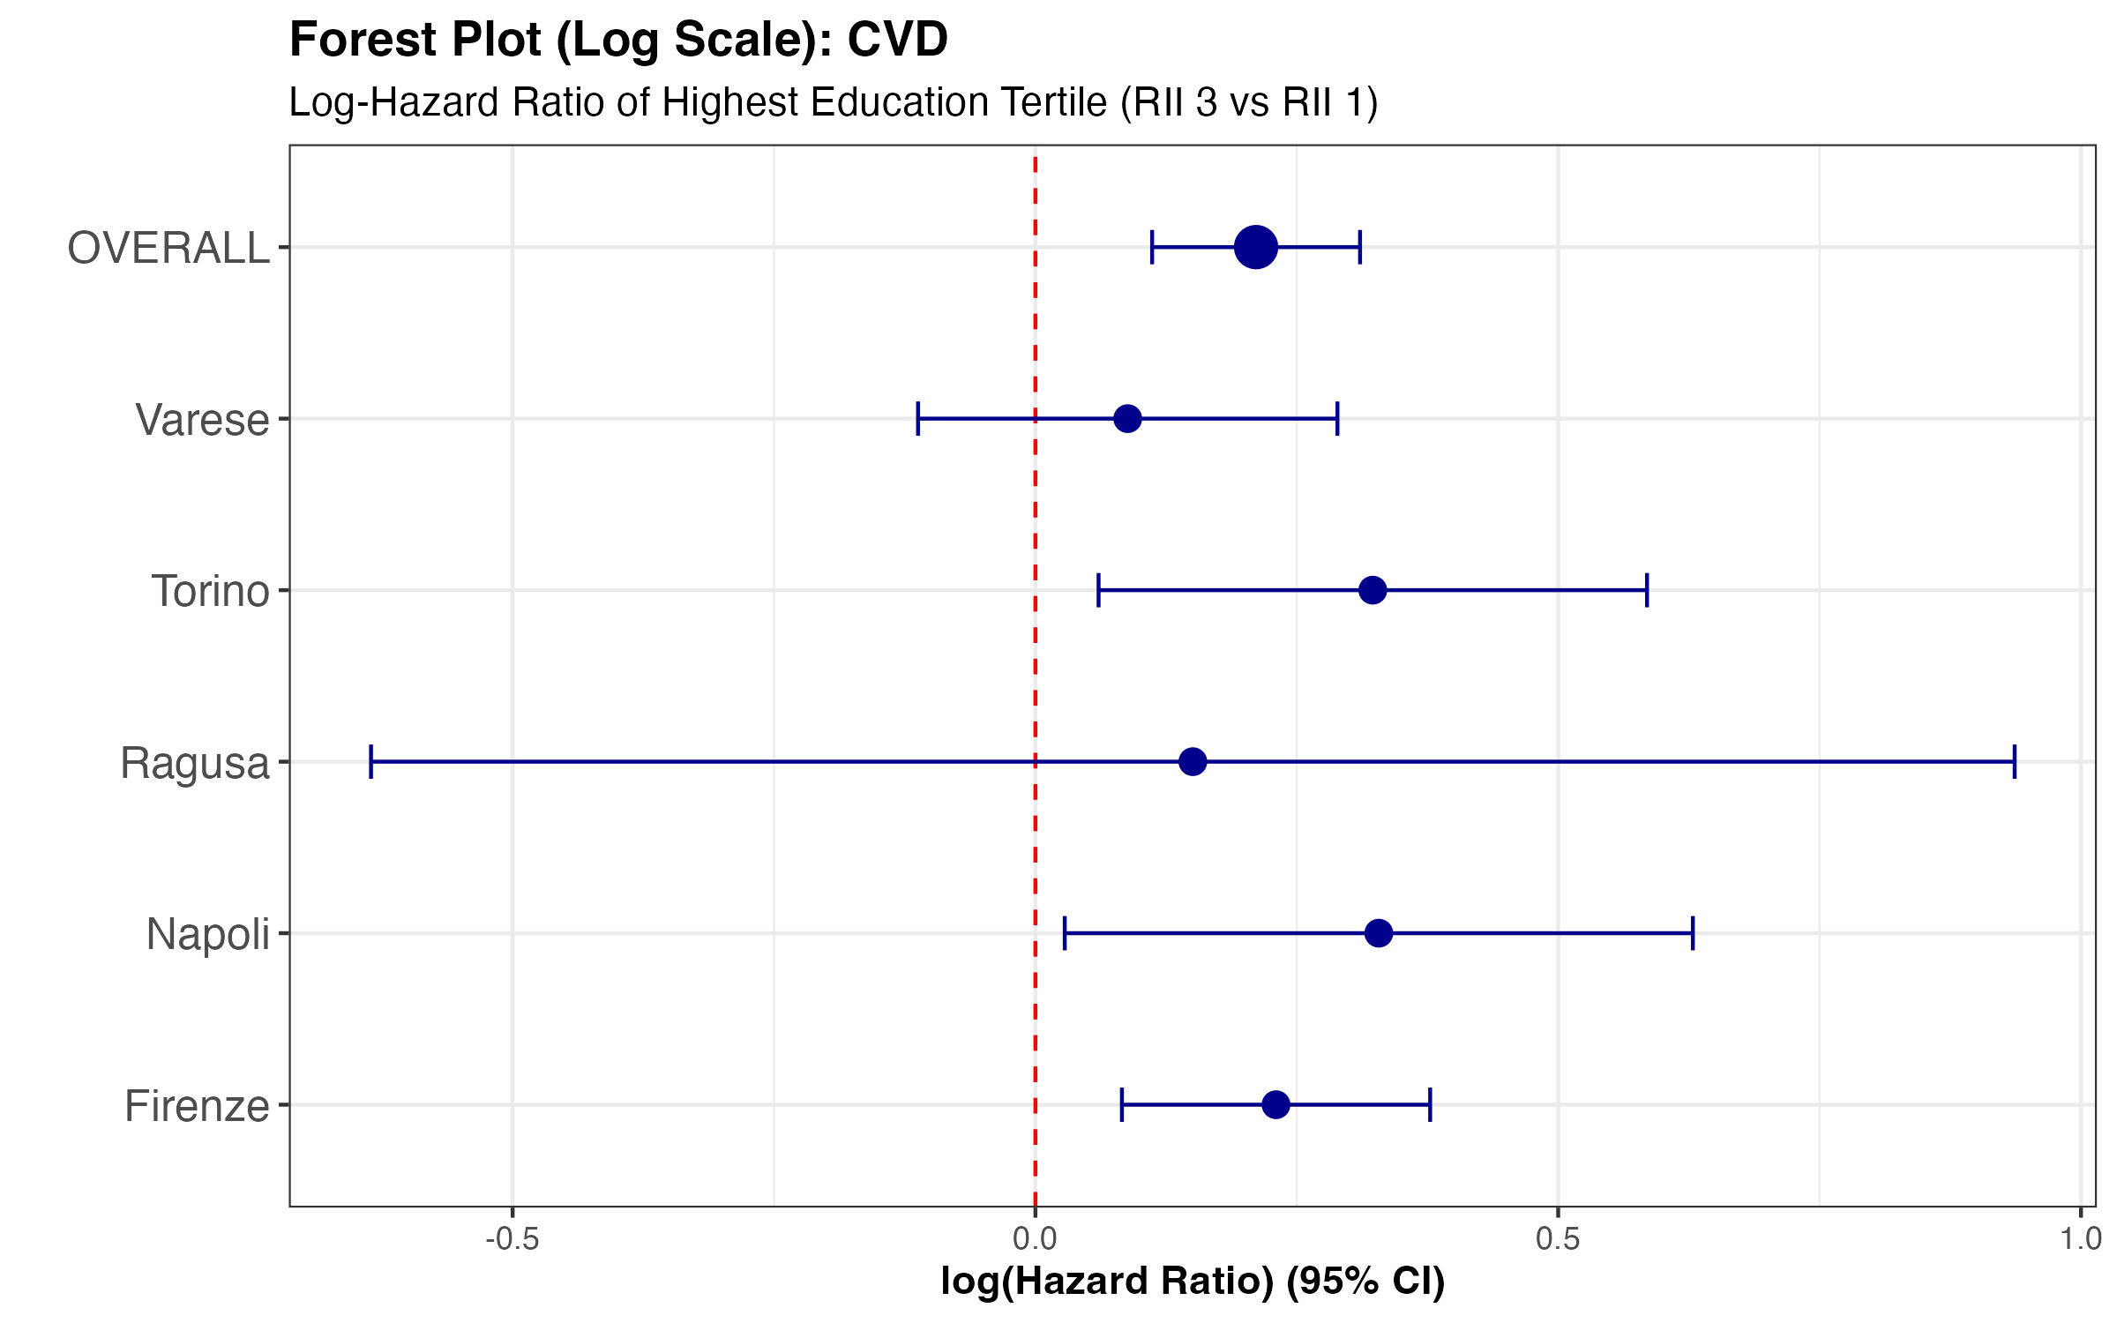
Survival Analysis
N=674
Population = 9,050
N=403
N=1,218
Population = 3,097
Population = 9,713
N=278
Population = 4,585
N=53
Population = 3,049

Slide 19
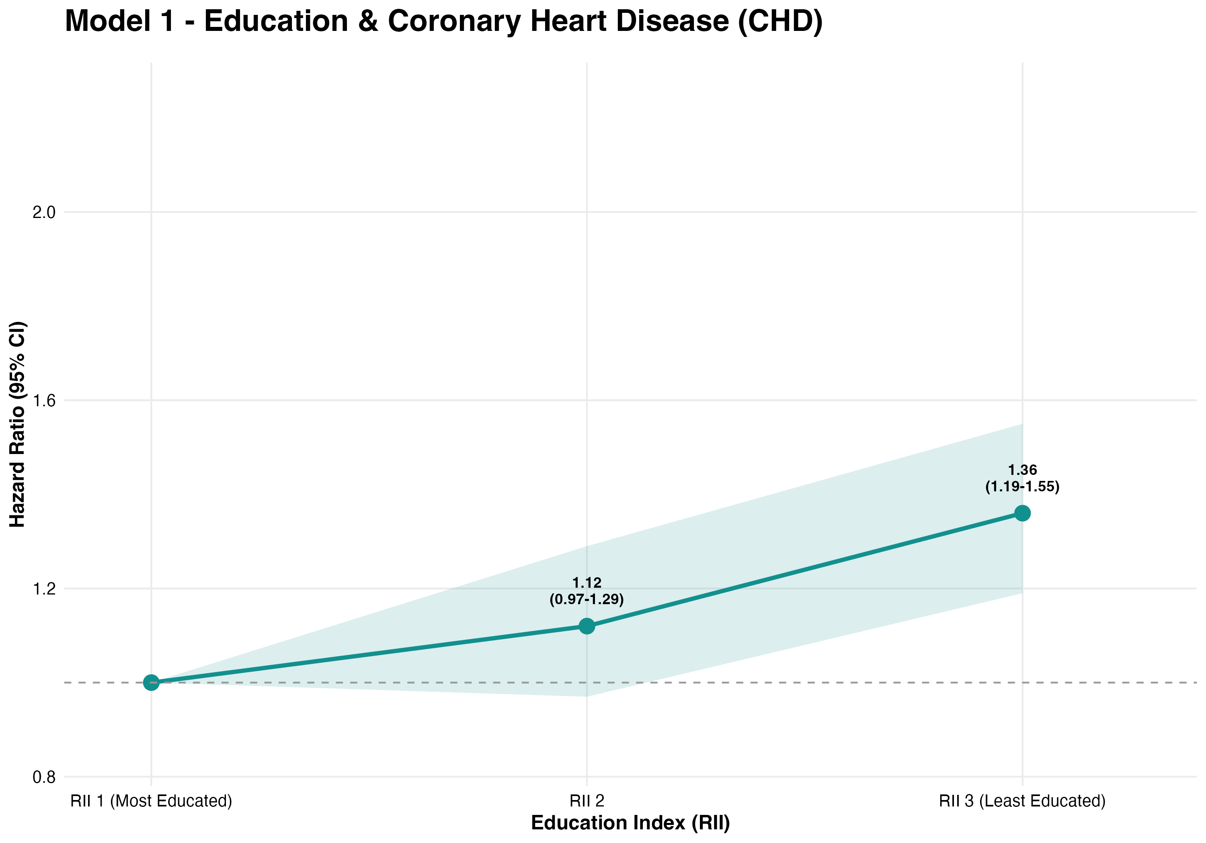
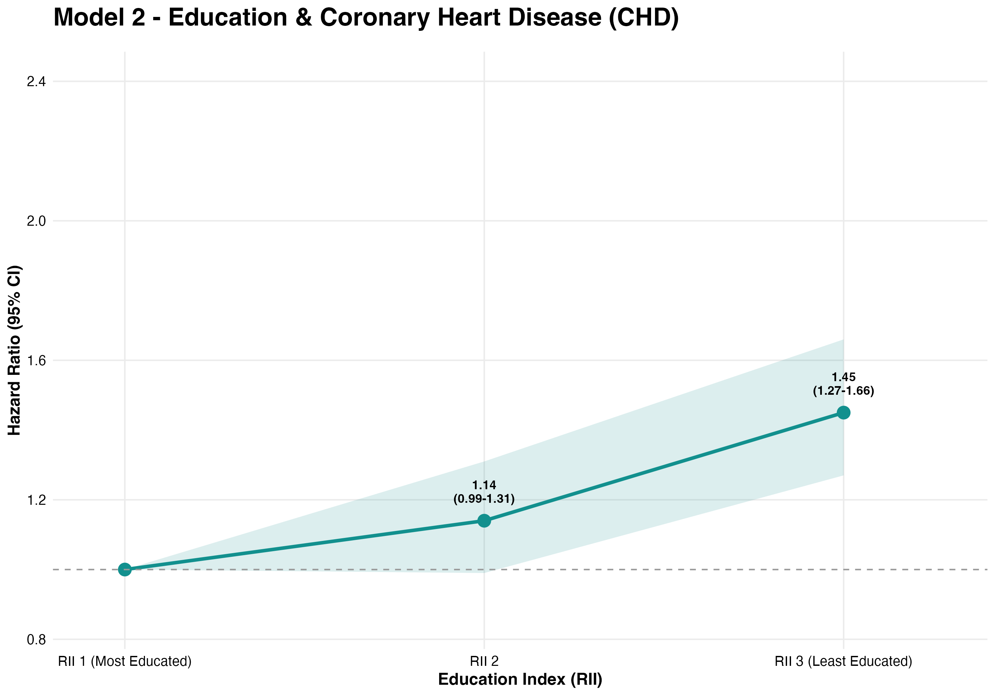
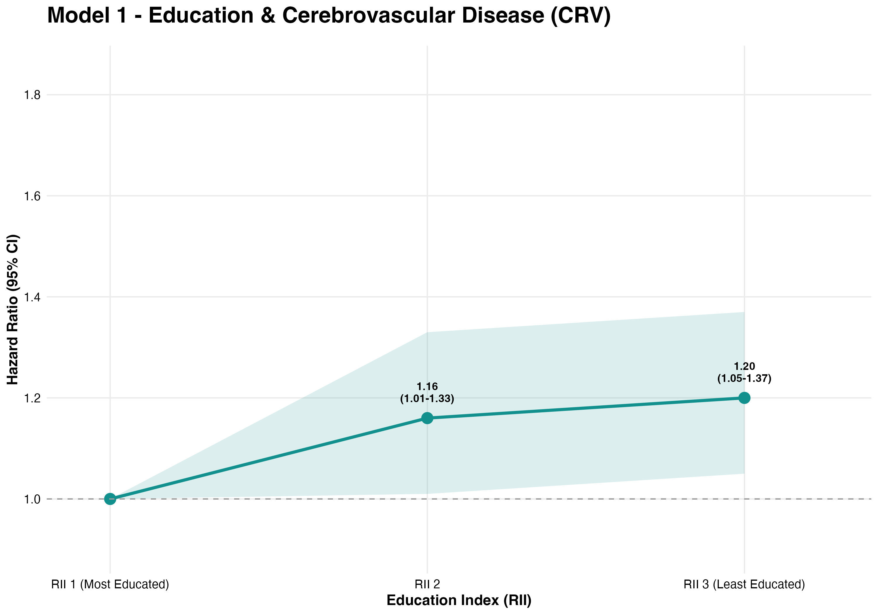
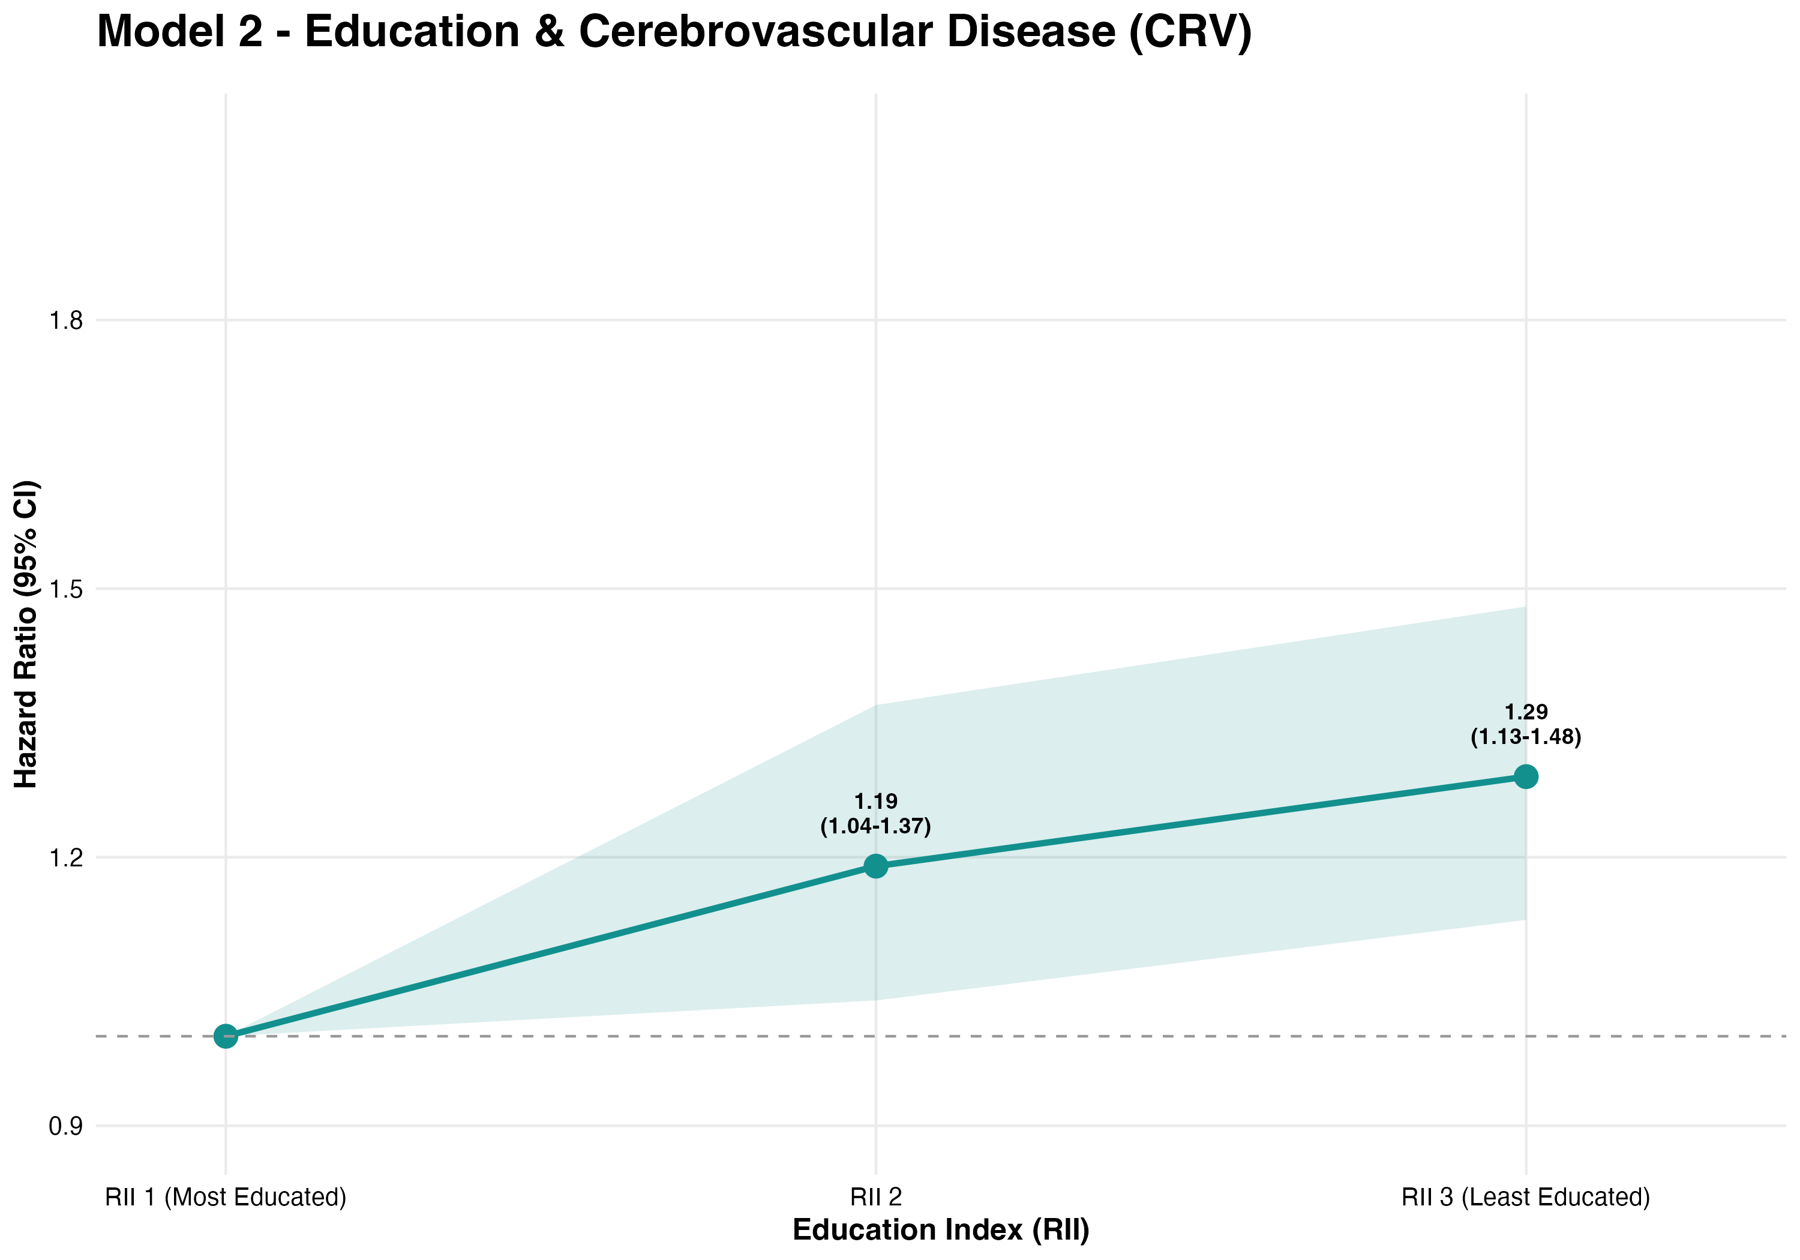




Survival Analysis
Coronary Heart Disease
 | Model 1 |  |  | Model 2 |  |  | Model 3 |  |  | Model 4
 | HR | 95% CI | p-value | HR | 95% CI | p-value | HR | 95% CI | p-value | HR | 95% CI | p-value
Education Index
RII 3 vs RII 1 | 1.36 | 1.19-1.55 | <0.001 | 1.45 | 1.27-1.66 | <0.001 | 1.34 | 1.17-1.53 | <0.001 | 1.31 | 1.14-1.50 | <0.001
p-value for trend |  |  | <0.001 |  |  | <0.001 |  |  | <0.001 |  |  | <0.001
Model 1: adjusted for systolic blood pressure, menopause, diabetes; Model 2: adjusted for physical activity, energy intake, alcohol, smoking status; Model 3: adjusted for BMI and Delta Waist; Model 4: full-adjusted.
Cerebrovascular Disease
 | Model 1 |  |  | Model 2 |  |  | Model 3 |  |  | Model 4
 | HR | 95% CI | p-value | HR | 95% CI | p-value | HR | 95% CI | p-value | HR | 95% CI | p-value
Education Index
RII 2 vs RII 1 | 1.16 | 1.01-1.33 | 0.040 | 1.19 | 1.04-1.37 | 0.012 | 1.18 | 1.03-1.36 | 0.017 | 1.16 | 1.01-1.34 | 0.034
RII 3 vs RII 1 | 1.20 | 1.05-1.37 | 0.007 | 1.29 | 1.13-1.48 | <0.001 | 1.26 | 1.10-1.44 | <0.001 | 1.20 | 1.05-1.37 | 0.009
p-value for trend |  |  | 0.007 |  |  | <0.001 |  |  | <0.001 |  |  | 0.010
Model 1: adjusted for systolic blood pressure, menopause, diabetes; Model 2: adjusted for physical activity, energy intake, alcohol, smoking status; Model 3: adjusted for BMI and Delta Waist; Model 4: full-adjusted.

Slide 20
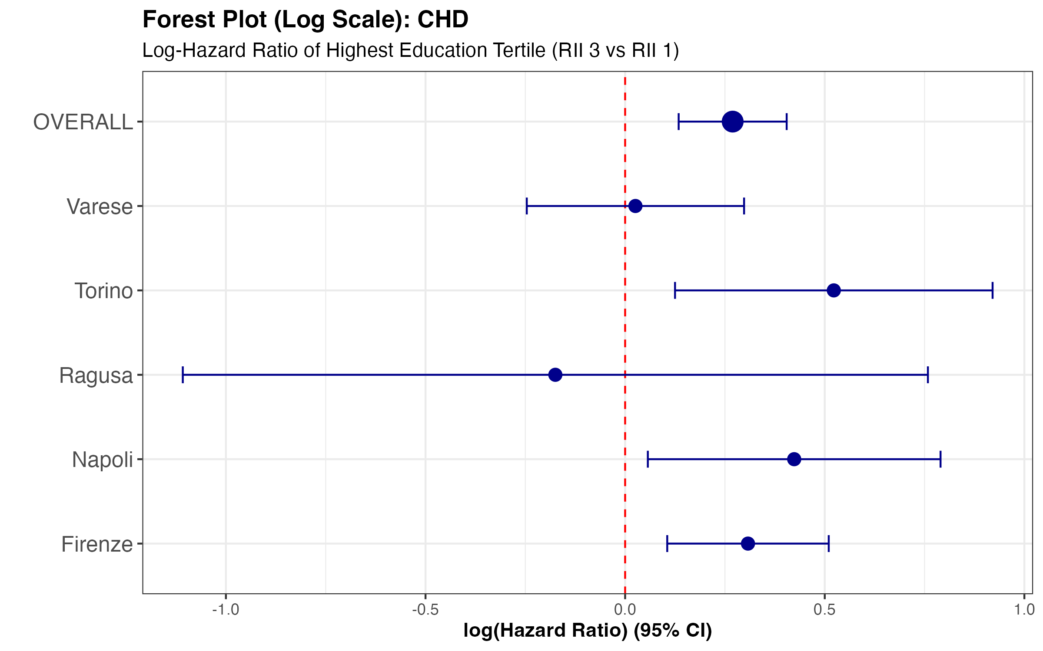
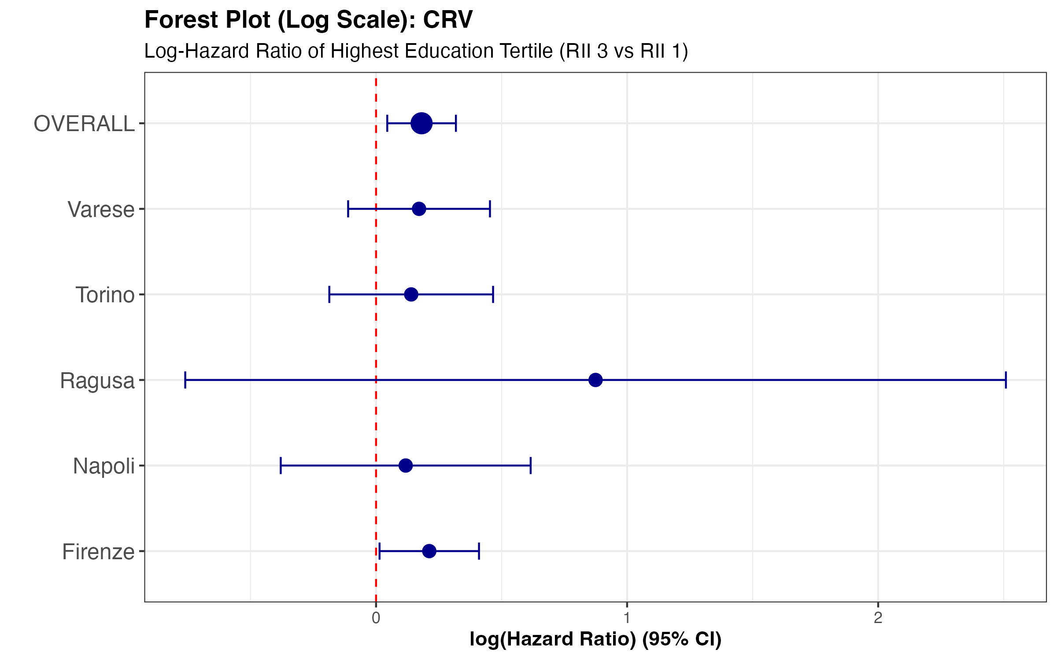
Survival Analysis
N=357 (CHD)
N=352(CRV)
Population = 9,050
N=181 (CHD)
N=256(CRV)
N=653 (CHD)
N=670 (CRV)
Population = 3,097
Population = 9,713
N=184 (CHD)
N=105 (CRV)
Population = 4,585
N=34 (CHD)
N=19 (CRV)
Population = 3,049

Slide 21
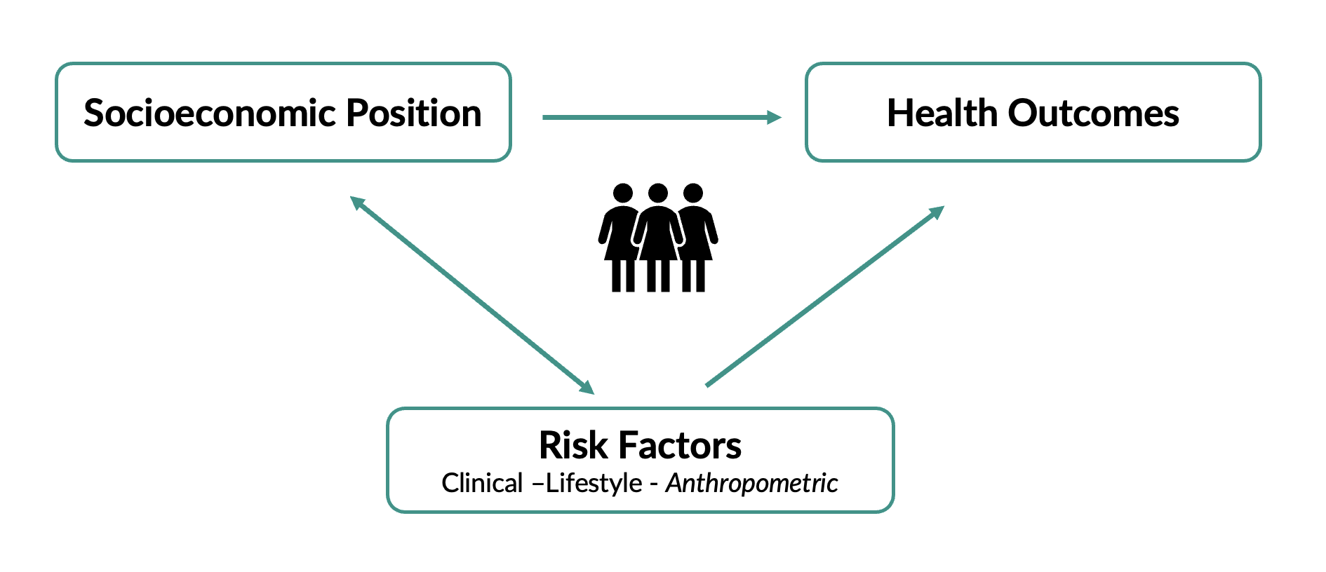
Conclusion
Deprivation Index 2001 Census
Relative Index of Inequality
Cardiovascular Disease
+23%
Mortality
+ 19 %
Coronary Heart Disease
+31%
Cerebrovascular Disease
+20%
*Risk increases estimated by full-adjusted models
Social disadvantage acts independently of risk factors.
Improving the quality of the living context.
Improving access to education.

Slide 22
Thank You
Thank you all for your attention.
Associazione tra Posizione Socio-Economica, Indicatori Antropometrici ed Esiti di Salute in una Coorte Femminile Italiana (Studio EPIC-Italia)
Teresa Speranza; Vittorio Simeon, Nicola Caranci; Valerio Vitale; Claudia Agnoli; Fulvio Ricceri; Lorenzo Milani; Benedetta Bendinelli; Melania Assedi; Rosario Tumino; Simona Signoriello; Paolo Chiodini.
Thanks to Unità di Statistica Medica, Università degli Studi della Campania «Luigi Vanvitelli»
for mentorship and guidance throughout this project.

